Slide 1
Serious Games and AI
Intro to AI Part 1 - Overview
Summer 2021
Notes:
1
1
Check distro statement before using:
DISTRIBUTION STATEMENT A. Approved for pubic release: distribution is unlimited.
This material is based upon work supported under Air Force Contract No. FA8721-05-C-0002 and/or FA8702-15-D-0001. Any opinions, findings, conclusions or recommendations expressed in this material are those of the author(s) and do not necessarily reflect the views of the U.S. Air Force.
© 2021 Massachusetts Institute of Technology.
Delivered to the U.S. Government with Unlimited Rights, as defined in DFARS Part 252.227-7013 or 7014 (Feb 2014). Notwithstanding any copyright notice, U.S. Government rights in this work are defined by DFARS 252.227-7013 or DFARS 252.227-7014 as detailed above. Use of this work other than as specifically authorized by the U.S. Government may violate any copyrights that exist in this work.

Slide 2
Topics Covered
What do we mean by “AI”
Types of Machine Learning
Examples
Course Focus

Slide 3
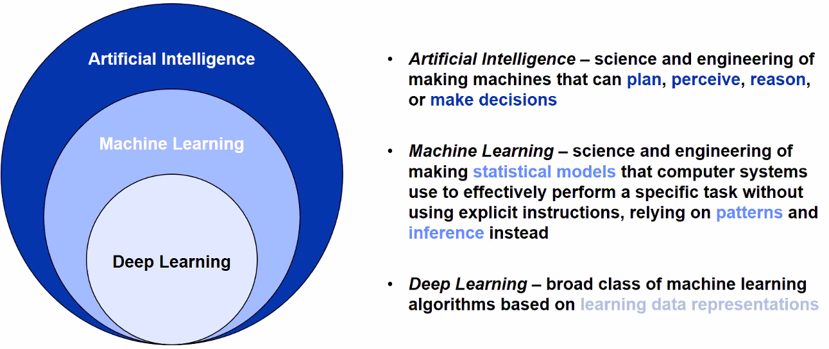
AI
What most people mean: Marketing Buzzword
What is it for this course:
Algorithms (procedures, methods) enabled by constraints exposed by representations that model targeted thinking, perception, and action
Modeling Examples: simulations, differential equations, probability
Notes:
Content adapted from:
1) MIT 6.034: https://ocw.mit.edu/courses/electrical-engineering-and-computer-science/6-034-artificial-intelligence-fall-2010/. Source: https://ocw.mit.edu/courses/electrical-engineering-and-computer-science/6-034-artificial-intelligence-fall-2010/lecture-videos/lecture-1-introduction-and-scope/
2) UPenn CIS519: https://www.seas.upenn.edu/~cis519/spring2020/. Source: https://www.seas.upenn.edu/~cis519/fall2017/lectures/01_introduction.pdf

Slide 4
Machine Learning
Machine Learning
Supervised Learning
Regression
Classification
Unsupervised Learning
Clustering / Dimension Reduction
Semi-supervised Learning
Control / Classification
Clustering / Classification
Reinforcement Learning

Slide 5
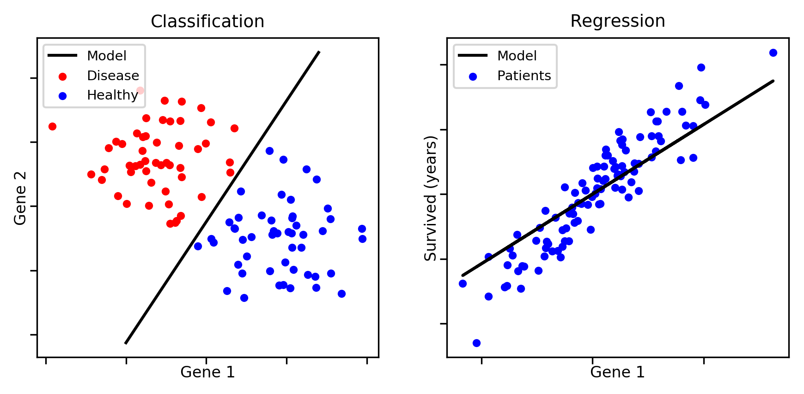
Supervised Learning
Using labeled data, learn a discrete mapping from features to class (classification)
Using labeled data, learn a continuous mapping from features to class (regression)
Notes:
https://aldro61.github.io/microbiome-summer-school-2017/sections/basics/

Slide 6
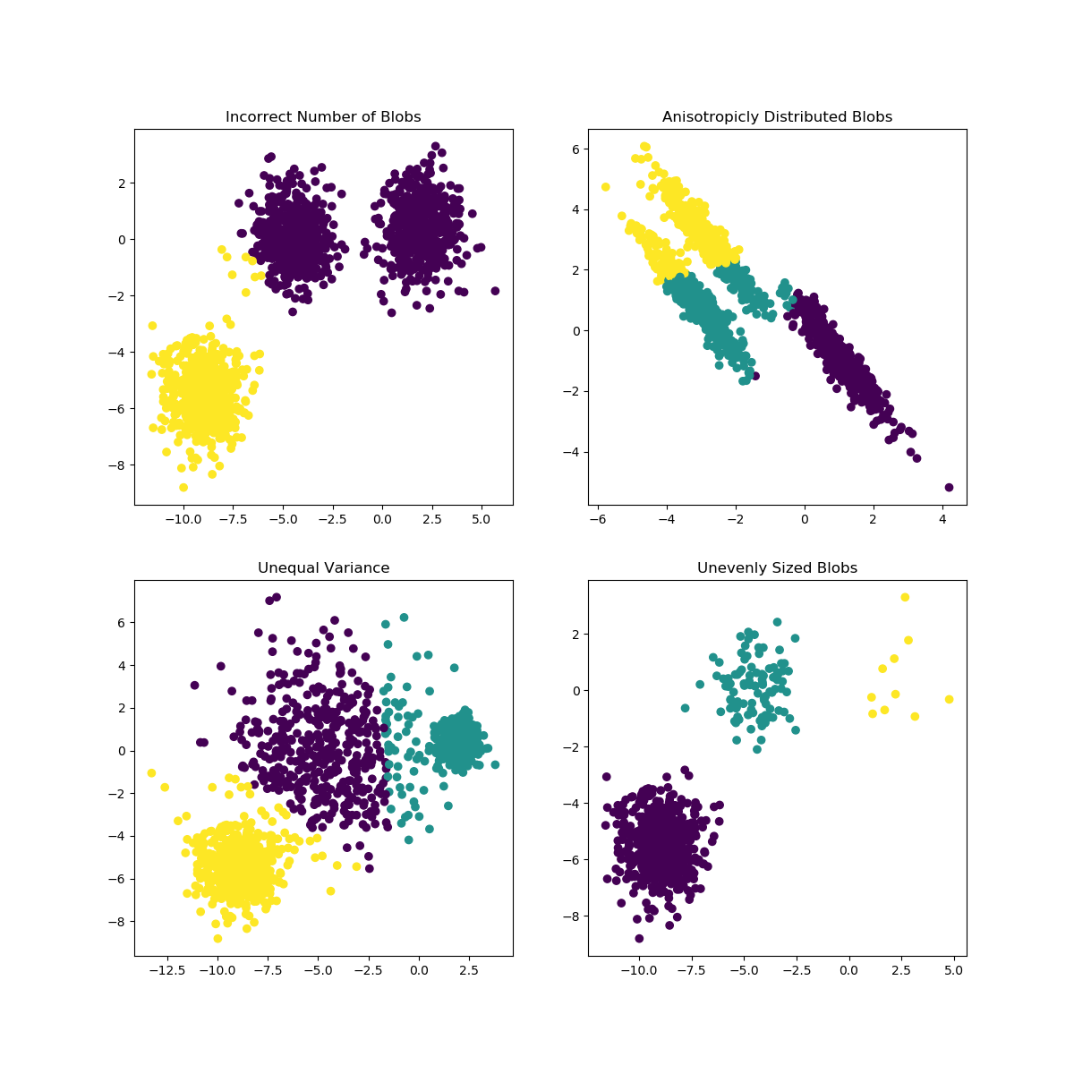
Unsupervised Learning
No labels, instead, trying to discover underlying features of the data
Clustering data into groups
Dimensionality reduction
Feature selection
Notes:
https://scikit-learn.org/stable/modules/clustering.html#k-means

Slide 7
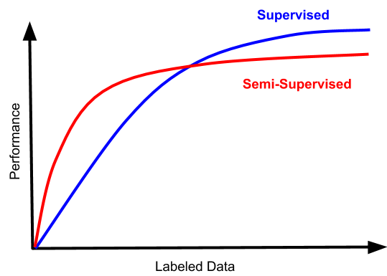
Semi-supervised Learning
Mixture of labeled and unlabeled data

Slide 8
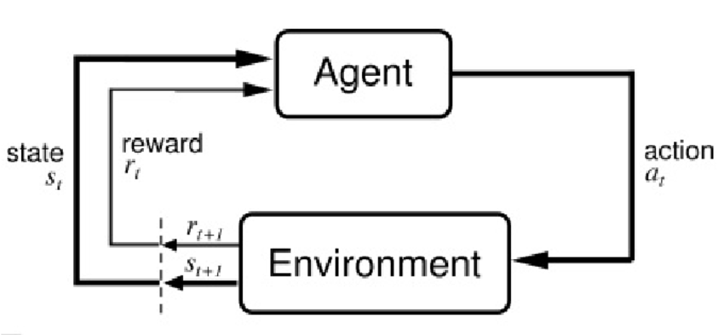
Reinforcement Learning
RL as a decision making process:
Environment: Model that allows agents to take actions and provides state and reward signals
State: The environment’s current situation
Actions: What the agent is allowed to do within the environment
Reward: Incentive or penalty associated with taking an action within an environment
Policy: Mapping from past experience to action
Notes:
https://en.wikipedia.org/wiki/Reinforcement_learning

Slide 9
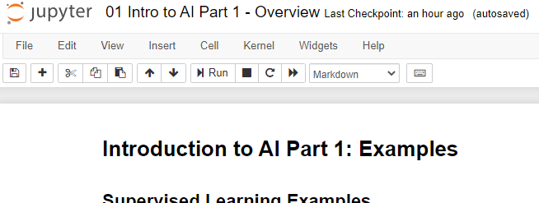
Examples
View in notebook

Slide 10
Course Focus
Reinforcement Learning
Game -> Custom OpenAI Gym environment
Concept: Use RL as an analysis tool to find strong strategies within the game

Slide 11




